Slide 1



CAPITAL STRUCTURE AND ITS IMPACT ON PROFITABILITY

Slide 2
TABLE OF CONTENT
EXECUTIVE SUMMARY ………………………………………………..…………. 01
INTRODUCTION ………………………………………………...………..………….02
DATA COLLECTION ……..………………………………............………..………....03
DATA ANALYSIS & DISCUSSION…………………………………………..…..…..04
CONCLUSION ………………………………………………………………..…..…..08
II

Slide 3
EXECUTIVE SUMMARY
This report is about a real-world problem related to finance. In this report, we analyze how the Debt to Equity Ratio (R/E), Debt to Asset Ratio(R/A), Capital Gearing Ratio, and Interest Coverage Ratio affect the Gross Profit Ratios (GPR). The main goal of the report is to investigate the relationship between Capital Structure and profitability using data from the highest market-capitalized listed companies.
Five leading companies were used for the study, which collected and analyzed data from the annual reports of each company published on the official website of the Colombo Stock Exchange. Further data were collected on a yearly basis from 2013 to 2022.
We have taken a panel data set and utilized STATA software to run the regression model.
We collected data from the annual reports of Expolanka Holdings PLC, LOLC Holdings PLC, John Keels Holdings PLC, LOLC Development Finance PLC, and LOLC Finance PLC.
Data from the above companies were first collected and then analyzed on how each company maintained its permanent variables and independent variables over a period of 10 years. We developed the econometrics model to continue our research according to our dependent and independent variables. It also provides a benchmark to compare companies with each other.
01

Slide 4
INTRODUCTION
The study objective is to discover the impact of capital structure on firm’s profitability and to explore optimal capital structure of highest market-capitalized listed companies. Each capital investment decision, including capital structure, is crucial since it has an impact on a company's profitability. Company can be financed through both equity and debt sources, and the proportionate combination of equity and debt is known as the capital structure of an organization. A company's capital structure can be thought of as its circulatory system. There has been a growing concern worldwide in detecting the variables associated with debt leverage (Voulgaris, Asteriou & agrimirgiankis,2004)
Performance of company is influenced by many of factors. Among these are aspects like the organization's liquidity and capital structure. According to (Modigliani and Miller 1958), an organization's capital structure has no bearing on its value. According to the thesis, capital structure has no bearing on a firm's success because organizations' values reflect their performance. However, with actual studies carried out by various researchers, the capital structure theory has been contested over time. In addition to prior studies, (Modigliani and Miller 1963) loosened the no tax assumption and created a capital structure theory while linking the tax advantages of indebtedness. Even though numerous capital structure theories, including agency cost, pecking order, and trade-off theories, have been created in recent years to assess their impact on business performance, they differ in their relative weight.
Our study makes an effort to investigate the relationship between Capital Structure and profitability using data from the highest market-capitalized listed companies. Debt to Equity Ratio (R/E), Debt to Asset Ratio(R/A), Capital Gearing Ratio, Interest Coverage Ratio are used to assess the capital structure of the companies while gross profit ratios assess profitability of the companies. In this study, relevant data was collected from annual reports of five company published on official website of Colombo Stock Exchange (CSE) covering 10 years period from 2013-2022.
02

Slide 5
DATA COLLECTION
The data for the econometric model was collected from secondary sources which is the annual reports of the relevant company. We have selected the top five market-capitalized listed companies from the Colombo Stock Exchange website. Furthermore, the time period for the study, FY13 to FY22 was considered.
Variable Classification
Dependent Variable
Firm Profitability - According to the topic of the study which is “Capital structure and its impact on profitability”, the dependent variable is the profitability of each company of the sample.
Independent Variables
D/E Ratio - D/E Ratio is calculated to evaluate a company’s financial leverage and it’s a measure of the degree to which a company is financing its operations with debt rather than its own resources.
D/A Ratio - Debt to Assets is another leverage ratio and it measures the relationship between the total liabilities and total assets of a company. It indicates the percentage of assets that are acquired using debt financing.
Interest Coverage Ratio - This is a debt and profitability ratio used to determine how easily a company can pay its interest through outstanding debt. To determine a company’s riskiness relative to its current debt or for future borrowings.
Variable Type | Variable | Formula | Abbreviation
Dependent Variable | Gross Profit Ratio | Gross profit/ Net Sales *100 | GPR
Independent Variable | D/E Ratio | Total Debt/ Total Equity | D/E
 | D/A Ratio | Total Debt/ Total Assets | D/A
 | Capital Gearing Ratio | Total Equity/ Total Debt | CG
 | Interest Coverage Ratio | Profit before Interest and tax / Fixed Interest Charges | IC
To run the regression model, the following hypotheses made according to the model.
Null Hypothesis | Alternative Hypothesis
H₀ 1: There is not an impact of D/E ratio on gross profit ratio. | H₁ 1: There is an impact of D/E ratio on gross profit ratio.
H₀ 2: There is not an impact of D/A ratio on gross profit ratio. | H₁ 2: There is an impact of D/A ratio on gross profit ratio.
H₀ 3: There is not an impact of capital gearing ratio on gross profit ratio. | H₁ 3: There is an impact of capital gearing ratio on gross profit ratio.
H₀ 4: There is not an impact of interest coverage ratio on gross profit ratio. | H₁ 4: There is an impact of interest coverage ratio on gross profit ratio.
03

Slide 6
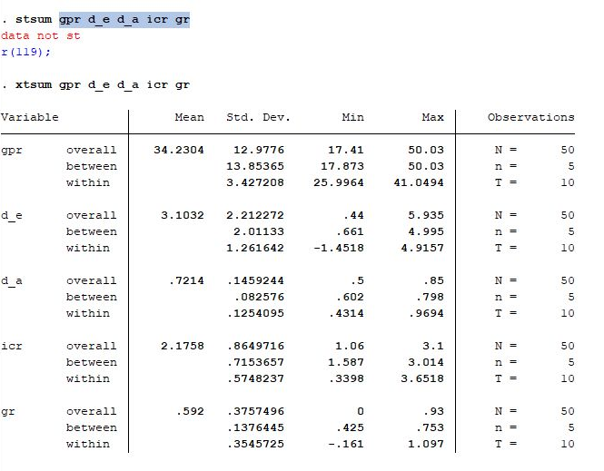
DATA ANALYSIS & DISCUSSION
The below linear regression model attempts to investigate the influence of selected independent variables on company’s gross profit ratio.
GPR= α + D/E. β₁ + D/A. β₂ + CG. Β₃ + β₄.IC + ε
Descriptive Statistics
Descriptive statics for the variables are given in table 2. Above table includes mean, standard deviation, min & max of the data that we used in the model.
As per the table gross profit ratio indicates mean value of 34.230 with a range from 17.410 to 50.030. therefore gross profit ratio express average payout during the study period. Mean value of the D/E report that 3.103 with minimum D/E of 0.44 and maximum of 5.935. further mean value of the D/A indicates the 0.721 while having minimum of 0.5 and maximum of 0.85. when it is come to icr it is indicates mean value of 2.4758 while recording minimum of 1.06 and maximum of 3.1. so there is no high deviation when it is come to icr also. Further more when it is come to gr it has a mean value of 0.592 and it is fluctuating between 0. and 0.93.
04

Slide 7
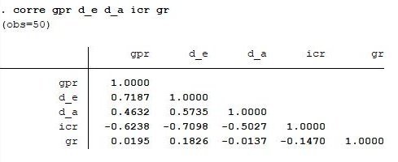
Correlation Analysis
Correlation analysis presented in the above table explains the association between independent variable and dependent variable. According to the table , there is negative relationship with icr. Positive relationships can be find between D/E , D/A and GR.
Regression Analysis
Fixed Effect Model and Random Effect Model
To run the panel data regression there are two models.
Fixed effect model use when – Between entities, the characteristics are different. But within the entity the characteristics do not vary.
Random effect model use when – The variation across the entities are random. And not totally different from one another. It’s computed through error term.
To find whether to use fixed or random effect model we use “Hausman test”.
Hausman Test
Using hausman test, we identified the best model for our panel data.
H0: Preferred model is random
H1: Preferred model is fixed
As per the results of below table , the probability is lower than 0.05. So we reject null hypothesis. Then our preferred model is fixed effect model.
05

Slide 8
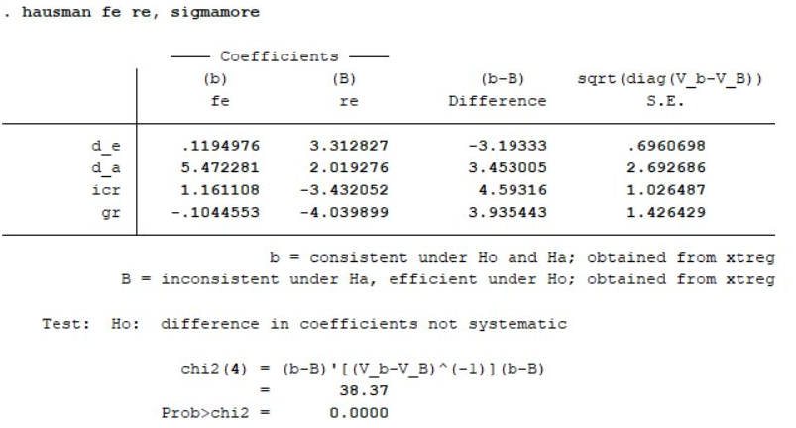
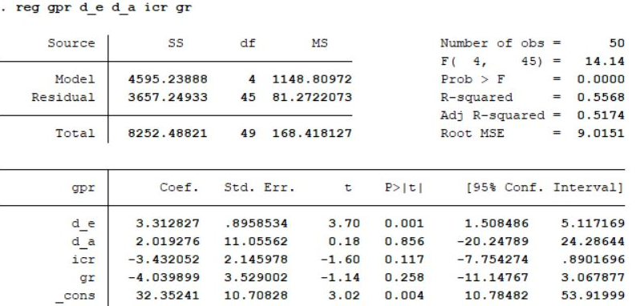
Selecting Fixed Effect VS OLS Model
Because our model is fixed effect model we have to select either fixed or OLS model to proceed.
F test value come to 0.69 with a probability of F=0.6002 and this is greater than 0.05 we have to proceed with OLS model.
OLS Model
According to the OLS model panel data regression function as,
GPR = 32.3524 + 3.3128 D/E + 2.0192 D/A -3.4320 ICR – 4.0398GR
D/E and the constant are the only variables that are significant in this model (t values are greater than 2) . they are significant at 5% confidence level. The R-squared value is 0.5568 that means GPR can be explained by 55.68%. from the independent variables.
06

Slide 9
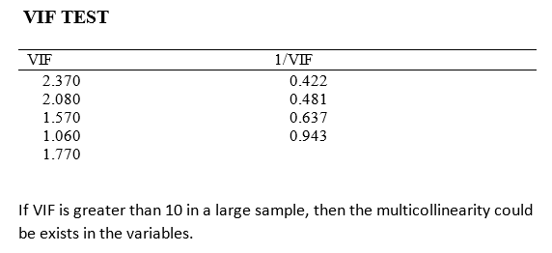
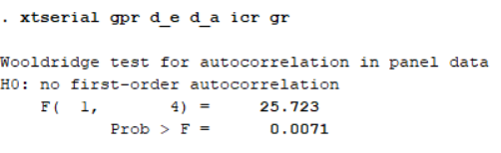
Interpretations of coefficients
INTERCEPT (α)- When all the independent variables are equal to zero, GPR of the firm will be 32.3524.
D/E. β₁ -If the D/E increases by 1%, the GPR of Firm will increase by 3.3128%, when other variables are held constant.
D/A. β₂ - If the D/A increases by 1%, the GPR of the firm will increase by 2.0192%, when other variables are held constant.
ICR. Β₃ - if the ICR increase by 1%, the GPR of the firm will decrease by 3.4320%, when other variables are held constant.
GR. Β₃ - if the GR increase by 1%, the GPR of the firm decrease by 4.0398%, when other variables are held constant.
Multicollinearity
Above table shows the variable inflation factor testing multicollinearity. According to the results the model does not include multicollinearity since all the VIF values are lesser than 5.
Autocorrelation
Since Probability > F < 0.05 we have to conclude that there is first-order autocorrelation.
07

Slide 10
CONCLUSION
The gross profit ratio is a measure of a company's profitability that compares the gross profit to the total revenue. It is an important indicator of a company's efficiency and ability to generate profits. Throughout this assignment it is determine the impact of the gross profit ratio when the debt to equity ratio, debt to asset ratio, interest coverage ratio and gearing ratio toward gross profit ratio.
We took debt to equity ratio, debt to asset ratio, interest coverage ratio, gearing ratio as our independent variables and gross profit margin ratio as our dependent variable for this study. We ought to apply the linear regression method in order to do such a study.
This study can be used to clarify the relationship between several different independent variables and a dependent variable. Relevant information was gathered for this study from the annual reports of each company that were posted on the Colombo Stock Exchange's official website. We considered 05 of the S&P SL20 companies and also, all data was collected on an annual basis from 2013 to 2022. Conclusion
We have perfect multicollinearity when there is an exact linear relationship between two or more independent variables. Then, using STATA, we performed the variance inflation factor command to find the multicollinearity. Firm size and the constant are the only variables that are significant in this model ( t values are greater than 2).
They are significant at 5% confidence level and even at 1%.. The overall R² value is 0.5568.
To answer the question of the level of intensity of factors, coefficient of these factors can be considered and accordingly as a conclusion we can say that Debt to asset ratio, debt to equity ratio, gearing ratio records a positive relationship with the value of the firm’s gross profit margin. In the meantime interest coverage ratio shows a negative relationship towards the value of the firm’s gross profit ratio. by using T test we can conclude that other than D/E ratio all the other variables are significant. thats mean D/A ratio ICR GR has significant impact on GPR
08

